Slide 1
WEB TECHNOLOGIES
BY SHAILESH KUMAR KHANCHANDANI

Slide 2
Topics Covered
Overview of HTML – Tags, Attributes and Styles. Designing webpages with HTML5 – Tags & Attributes.
Introduction to character encoding, compression, MIME types, document standards and meta tags.
Introduction to CSS – Selector Rules, Typography, Layout, Appearance and Animations.

Slide 3
Document Standards
Document standards refer to specifications and guidelines that define how documents should be structured, formatted, and interpreted. They ensure consistency, interoperability, and compatibility across different systems and applications. Examples of document standards include HTML (Hypertext Markup Language) for web pages, XML (eXtensible Markup Language) for data exchange, PDF (Portable Document Format) for electronic documents, and DOCX for Microsoft Word documents. Adhering to document standards facilitates seamless communication and data exchange between different software and platforms.

Slide 4
Character Encoding: Making Sure Your Symbols Speak the Same Language
Character encoding ensures all these characters are displayed correctly on any web browser. It's like a translator between the characters you use and the ones the computer understands.
Common character encodings include:
UTF-8: The most widely used encoding, supporting a vast range of characters.
ISO-8859-1 (Latin-1): Commonly used for Western European languages.

Slide 5
HTML
HTML, standing for HyperText Markup Language, is the foundation of web pages. It's the code that web browsers use to understand and display the content and structure of a web page. Here's a breakdown of what HTML is all about:
Building Blocks: Tags and Elements
A document with special instructions hidden within. These instructions, written in angle brackets (< and >), are called HTML tags. Tags are used to define different parts of a web page, like headings, paragraphs, images, and links. The text surrounded by these tags defines the content. The combination of a tag and its content is called an HTML element.
For example, the tag <h1> defines a heading level 1, and the text between the opening and closing tags (<h1></h1>) becomes the heading content.

Slide 6
The Big Picture: Structure and Content
HTML provides a framework for web pages. It defines the structure of the content, but it doesn't specify the visual style (like font size or color). That's where CSS comes in.
An HTML document typically follows a specific structure:
DOCTYPE declaration: This line specifies the document type as HTML.
<html> element: This is the root element of the HTML document and contains all other elements.
<head> element: This section contains meta information about the page, like the title and character encoding.
<body> element: This section contains the visible content of the web page, like headings, paragraphs, images, and links.

Slide 7
Creating Hyperlinks: The Power of the Web
One of the defining features of HTML is its ability to create hyperlinks. These are links that, when clicked, take you to another web page. This creates the interconnected web of information that we know and love! Hyperlinks are defined using the <a> tag, with the destination web page specified as an attribute.
Learning HTML: Getting Started
HTML is a relatively easy language to learn, even for beginners. There are many resources available online, including tutorials and interactive exercises. You can write HTML code in a simple text editor and save the file with a .html extension. Opening this file in a web browser will display the web page you've created!
By understanding the basics of HTML, you can start building your own web pages and contribute to the vast world of the web.

Slide 8
Tags: The Foundational Framework
Imagine a web page as a blueprint. HTML tags act like the labels on that blueprint, defining the structure and content of the page. These tags are written in angle brackets (< and >), and they come in pairs – an opening tag and a closing tag.
The content between the opening and closing tags defines what that section of the page represents. For example, the tag <h1> defines a level 1 heading, and the text between the tags becomes the heading content. Common tags include <h1> for headings, <p> for paragraphs, <img> for images, and <a> for links.
Attributes: Adding Details and Functionality
While tags define the basic structure, attributes provide additional information about how that element should behave or appear. Attributes are specified within the opening tag of an element, and they come in the form of name-value pairs separated by an equal sign (=).
For instance, the <img> tag has an attribute named src that specifies the location of the image file. Another example is the <a> tag, which has an href attribute that defines the link's destination URL. Attributes can also be used to control the size, color, or alignment of elements.

Slide 9
Styles: The Art of Design
Tags and attributes define the structure and functionality of a web page, but they don't dictate the visual appearance. That's where CSS (Cascading Style Sheets) comes in. However, HTML itself has a limited styling capability through the style attribute.
The style attribute allows you to define inline styles for an element directly within the opening tag. It consists of CSS property-value pairs separated by colons (:). While convenient for simple styling, it's generally recommended to use separate CSS files for better organization and maintainability of complex web pages.

Slide 10
HTML5 tags and attributes
HTML5 tags are the building blocks of a webpage. They define the content and structure of a webpage. Common HTML5 tags include <header>, <nav>, <section>, <article>, <aside>, <footer>, <h1> to <h6> for headings, <p> for paragraphs, <a> for links, <img> for images, and <ul> for unordered lists.
HTML5 attributes provide additional information about an HTML element. Attributes are used within the start tag of an HTML element. Examples of common attributes include id, class, src, href, alt, and style.
For example, the <img> tag is used to embed images into a webpage. The src attribute specifies the path to the image file. The alt attribute provides alternative text for the image, which is useful for accessibility and SEO.

Slide 11
Structure
<!DOCTYPE html>
<html>
<head>
<title>My Webpage</title>
</head>
<body>
<h1>Welcome to my Page!</h1> <p>This is a paragraph with some content.</p> <img src="image.jpg" alt="My Image" style="width:200px;height:150px;"> <a href="https://www.google.com">Click here to visit another website!</a> </body>
</html>

Slide 12
Meta Tags: Adding Descriptive Details for Search Engines and More
Meta tags are snippets of information embedded within the HTML code of a web page. They don't affect the visual content of the page but provide important details to search engines and browsers. Here are some common meta tags:
Meta Description: A brief summary of the page's content, often used by search engines in search results.
Meta Keywords: Keywords relevant to the page's content, although their importance for search engine optimization (SEO) has diminished.
Meta Viewport: Controls how a web page is displayed on different devices.

Slide 13
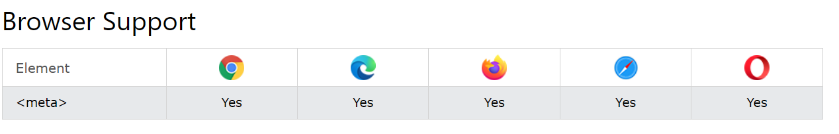
<head> <meta charset="UTF-8"> <meta name="description" content=“MBM University has been established by the Government of Rajasthan by upgrading the erstwhile M.B.M. Engineering College, Jodhpur. "> <meta name="keywords" content=“MBM, MBM UNIVERSITY"> <meta name="author" content=“admin_it"> <meta name="viewport" content="width=device-width, initial-scale=1.0"> </head>

Slide 14
Introduction to CSS
CSS (Cascading Style Sheets) is a stylesheet language used to control the presentation and layout of HTML (Hypertext Markup Language) documents. It allows web designers and developers to define the appearance and layout of web pages, including typography, colors, spacing, and animations. Here's an introduction to some key aspects of CSS:

Slide 15
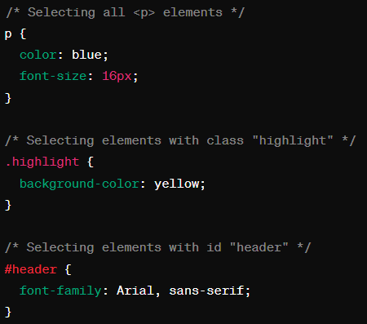
Selector Rules
CSS uses selector rules to apply styles to specific HTML elements. A selector targets one or more HTML elements, and a declaration block specifies the styles to apply to those elements. For example:

Slide 16
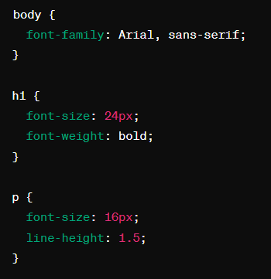
Typography
CSS allows you to control various aspects of typography, including font family, size, weight, style, line height, and text alignment. For example:

Slide 17
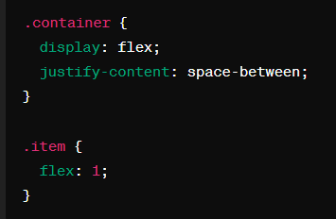
Layout
CSS provides mechanisms for creating responsive layouts that adapt to different screen sizes and devices. This includes techniques such as flexbox and CSS Grid Layout. Flexbox is a one-dimensional layout model that allows for flexible and efficient arrangement of items within a container, while CSS Grid Layout is a two-dimensional layout system for defining grid-based layouts. For example:

Slide 18
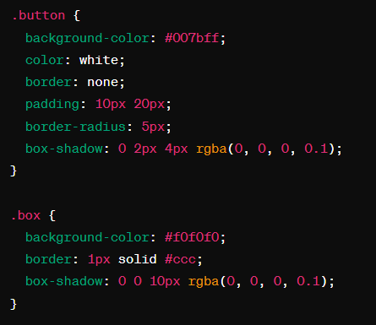
Appearance
CSS allows you to control the appearance of elements, including colors, backgrounds, borders, shadows, and gradients. For example:

Slide 19
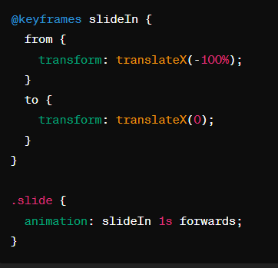
Animations
CSS allows you to create animations and transitions to add movement and interactivity to your web pages. This includes properties such as animation and transition, which can be used to animate properties like opacity, position, and scale. For example:

Slide 20
MIME Types: Telling the Browser What You've Got
MIME (Multipurpose Internet Mail Extension) types act like labels on web content. They tell the browser what kind of data it's dealing with (e.g., image, text, JavaScript). This ensures the browser uses the appropriate way to handle the content.
Here are some common MIME types:
text/html: HyperText Markup Language (HTML) files.
image/jpeg: JPEG image files.
image/png: PNG image files.
application/javascript: JavaScript files.
Document Standards: Building with Consistency

Slide 21
Compression
Compression is the process of reducing the size of a file or data to save storage space or transmission time. It is achieved by removing redundant or unnecessary information from the data. There are two types of compression: lossless compression, which preserves all data and allows the original data to be reconstructed exactly, and lossy compression, which sacrifices some data to achieve higher compression ratios. Common compression formats include ZIP, gzip, and JPEG

